Slide 1
Shortest zookeeper’s routes in simple polygons
Xuehou Tan
Information Processing Letters 77 (2001) 23–26
Speaker: Chia-Hung Chang

Slide 2
Abstract
Let P be a simple polygon, and let P be a set of disjoint convex polygons inside P, each sharing one edge with P. The zookeeper’s route problem asks for a shortest route inside P that visits (but does not enter) each polygon in P. We present an O(n2) time algorithm for computing a shortest zookeeper’s route, on which no starting point is specified.

Slide 3
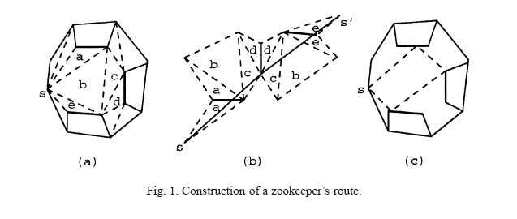
The main result

Slide 4
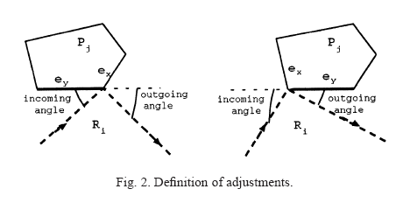

Slide 5
Lemma 1.
There are O(n) event points in the sliding
process.

Slide 6
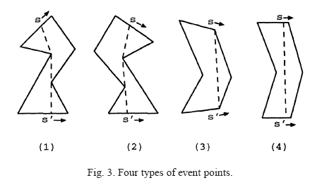

Slide 7
Lemma 2.
The shortest fixed zookeeper’s route Rs can be maintained in linear time when a new event point is encountered in the sliding process.

Slide 8
Theorem1.
The general shortest zookeeper’s route in a simple polygon (without giving any starting point) can be found in O(n2) time.

Slide 9
Conclusions
We have given an O.n2/ time algorithm for computing a shortest zookeeper’s route, on which no starting point is specified. The time bound of our algorithm might be further reduced (say, to O(n log2 n)).

Slide 10
END

